Slide 1

DATA COMPRESSION
A
Mini Project Report
Submitted in partial fulfillment of the
Requirements for the award of the Degree of
BACHELOR OF ENGINEERING
In
INFORMATION TECHNOLOGY
By
Rajesh Udathala (1602-19-737-150)
Rithik Keerthipati (1602-19-737-157)
Department of Information Technology
Vasavi College of Engineering (Autonomous)
(Affiliated to Osmania University)
Ibrahimbagh, Hyderabad-31
2020

Slide 2
Vasavi College of Engineering (Autonomous)
(Affiliated to Osmania University)
Hyderabad-500 031
Department of Information Technology
DECLARATION BY THE CANDIDATE
We, Rajesh Udathala and Rithik Keerthipati , bearing hall ticket numbers, 1602-19-737-150 and 1602-19-737-157, hereby declare that the project report entitled “Data Compression” is submitted in partial fulfillment of the requirement for the award of the degree of Bachelor of Engineering in Information Technology.
This is a record of bonafide work carried out by us and the results embodied in this project report have not been submitted to any other university or institute for the award of any other degree or diploma.
Udathala Rajesh
1602-19-737-150
Rithik Keerthipati
1602-19-737-157

Slide 3
ACKNOWLEDGEMENT
We are heartily thankful to our guides, Dr. Divya Lingineni and Dr. Ramesh Vasappanavara whose encouragement, guidance and support enabled us to develop an understanding of the subject and made it possible for us to complete this project. We offer our regards to all the respected professors who have taught us since their contribution towards our knowledge has been immense enabling us to work on this project.
- Udathala Rajesh and Rithik Keerthipati

Slide 4
ABSTRACT
“Data Compression” is an approach to text compression originally developed by David A. Huffman using Huffman Coding while he was a Ph.D. student at MIT, and published in the 1952 paper "A Method for the Construction of Minimum-Redundancy Codes". In computer science and information theory, it is one of many lossless data compression algorithms. It is a statistical compression method that converts characters into variable length bit strings and produces a prefix code. Most frequently occurring characters are converted to shortest bit strings; least frequent, the longest.

Slide 5
CONTENTS
Page no.
Certificate
Declaration
Acknowledgement
Abstract
Introduction 1 - 3
Technology 4
a. Software Requirements
b. Hardware Requirements
Proposed Work
a. Design 5 - 14
b. Implementation 15 - 29
Results 30 - 34
Additional Knowledge 35
Conclusion and Future work 36
References 37

Slide 6
INTRODUCTION
Huffman Coding
Let us suppose, we need to store a string of length 1000 that comprises characters a, e, n, and z. To store it as 1-byte characters will require 1000 byte (or 8000 bits) of space. If the symbols in the string are encoded as (00=a, 01=e, 10=n, 11=z), then the 1000 symbols can be stored in 2000 bits saving 6000 bits of memory.
The number of occurrences of a symbol in a string is called its frequency. When there is considerable difference in the frequencies of different symbols in a string, variable length codes can be assigned to the symbols based on their relative frequencies. The most common characters can be represented using shorter codes that are used for less common source symbols. More is the variation in the relative frequencies of symbols, it is more advantageous to use variable length codes for reducing the size of coded string. Since the codes are of variable length, it is necessary that no code is a prefix of another so that the codes can be properly decoded. Such codes are called prefix codes (sometimes called "prefix-free codes", that is, the code representing some particular symbol is never a prefix of the code representing any other symbol). Huffman coding is so much widely used for creating prefix codes that the term "Huffman code" is sometimes used as a synonym for "prefix code" even when such a code is not produced by Huffman's algorithm. Huffman was able to design the most efficient compression method of this type: no other mapping of individual source symbols to unique strings of bits(i.e. codes) will require less space for storing a piece of text when the actual symbol frequencies agree with those used to create the code.
Huffman Tree
First of all, the source symbols along with their frequencies of occurrence are stored as leaf nodes in a regular array, the size of which depends on the number of symbols, n. A finished tree has up to n leaf nodes and n − 1 internal nodes.
1

Slide 7
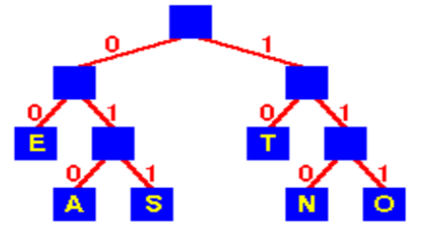
Basic Technique
In Huffman Coding , the complete set of codes can be represented as a binary tree, known as a “Huffman tree”. This Huffman tree is also a “Coding tree” i.e. a full binary tree in which each leaf is an encoded symbol and the path from the root to a leaf is its code-word. By convention, bit '0' represents following the left child and bit '1' represents following the right child. One code bit represents each level. Thus more frequent characters are near the root and are coded with few bits, and rare characters are far from the root and are coded with many bits.
Problem Definition
Given
A set of symbols and their weights (usually proportional to probabilities or equal to their frequencies).
Find
A prefix-free binary code (a set of code-words) with minimum expected code-word length (equivalently, a tree with minimum weighted path length from the root).
2

Slide 8
Optimal Merge
Let D = {n1, ... , nk} be the set of lengths of sequences to be merged. Take the two shortest sequences, ni, nj∈ D, such that n≥ ni and n≥ nj ∀ n∈ D. Merge these two sequences. The new set D is D' = (D - {ni, nj}) ∪ {ni+nj}. Repeat until there is only one sequence. Since efficient priority queue data structures require O(log n) time per insertion, and a tree with n leaves has 2n−1 nodes, this algorithm operates in O(n log n) time. The worst case for Huffman coding (or, equivalently, the longest Huffman coding for a set of characters) is when the distribution of frequencies follows the Fibonacci numbers. If the estimated probabilities of occurrence of all the symbols is same and the number of symbols are a power of two, Huffman coding is same as simple binary block encoding, e.g., ASCII coding. Although Huffman's original algorithm is optimal for a symbol-by symbol coding (i.e. a stream of unrelated symbols) with a known input probability distribution, it is not optimal when the symbol-by-symbol restriction is dropped, or when the probability mass functions are unknown, not identically distributed, or not independent (e.g., "cat" is more common than "cta").
Joining trees by frequency is the same as merging sequences by length in optimal merge. Since a node with only one child is not optimal, any Huffman coding corresponds to a full binary tree.
3

Slide 9
TECHNOLOGY
a. Software Requirements
Software requirements mainly share out with defining the software resource requirements that need to be installed on a computer to provide optimal functioning of a particular application. These conditions are not included in the software installation package and need to be installed separately. In order to use Data Compression, the following are the prerequisites,
Operating System – Windows 7 and above
C++ Compiler
Editor – Any basic editor is preferable (Example: Notepad++)
b. Hardware Requirements
Hardware requirements refer to the common set requirements defined by any operating system or software application and are usually the physical computer resources. In this section we basically deal with primary memory, secondary memory, processing power. In order to use Data Compression, one should have the following,
Processor - Intel Core i5 and above
Memory – 4GB Ram
4

Slide 10
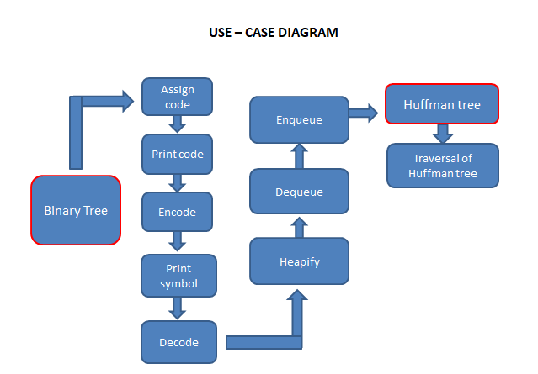
PROPOSED WORK
a. DESIGN
5

Slide 11
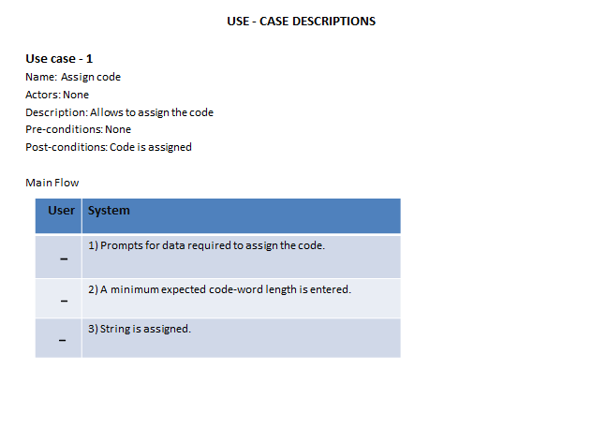
6

Slide 12
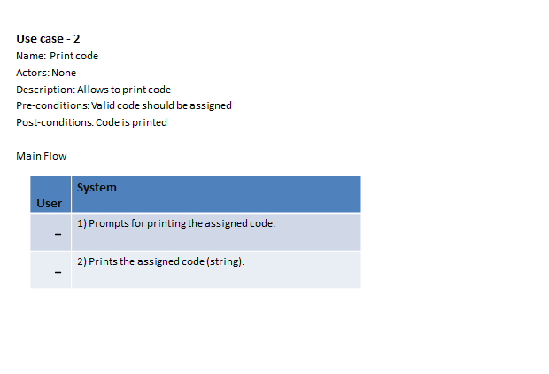
7

Slide 13
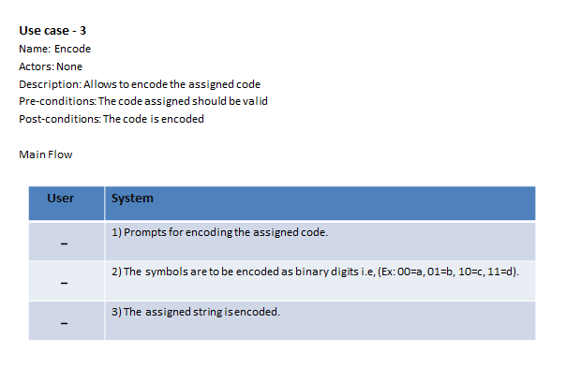
8

Slide 14
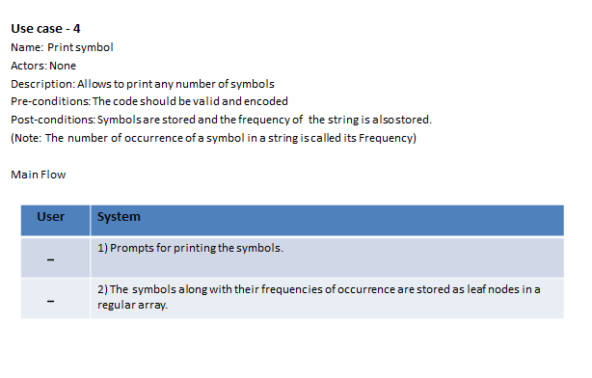
9

Slide 15
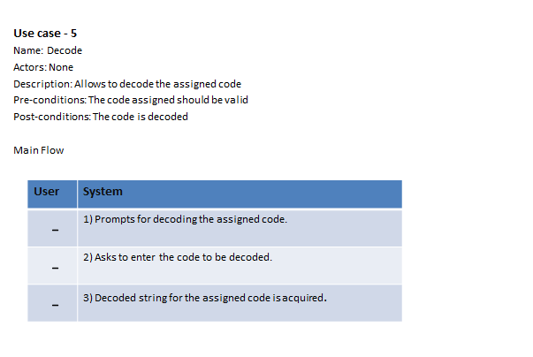
10

Slide 16
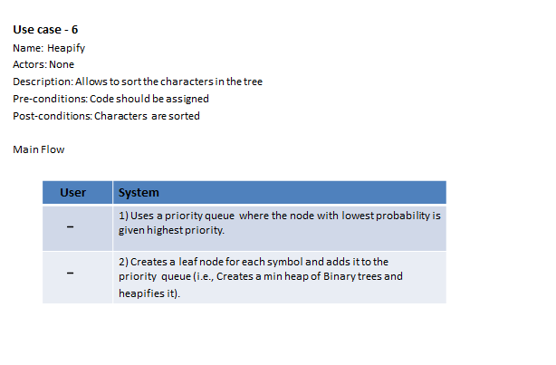
11

Slide 17
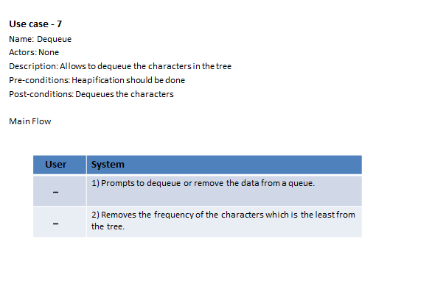
12

Slide 18
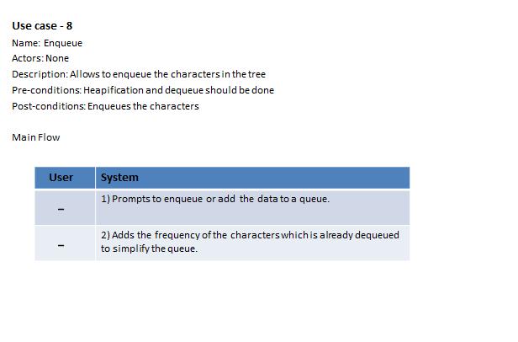
13

Slide 19
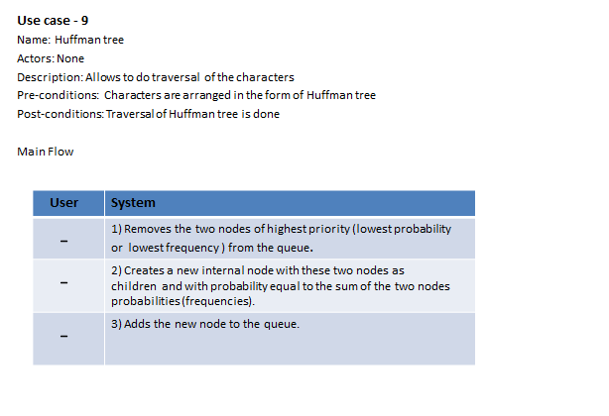
14

Slide 20
b. IMPLEMENTATION
#include <iostream>
#include <cmath>
using namespace std;
struct node
{
char info;
int freq;
char *code;
node *Llink;
node *Rlink;
};
class BinaryTree // Coding Tree
{
private:
node *root;
public:
BinaryTree() { root=NULL; }
void print();
void assign_code(int i);
void print_code(char c);
void encode(const char str[]);
void print_symbol(char cd[], int &f, int length);
void decode(char cd[], int size);
friend class minHeap;
friend class HuffmanCode;
};
15

Slide 21
class minHeap
{
private:
BinaryTree *T; // Array of Binary Trees
int n; // Number of symbols
public:
minHeap();
void heapify(int i);
BinaryTree dequeue(); // Returns the first Binary Tree of the min heap and // then heapify the array of Binary trees in order of the //frequencies of their root nodes.
void enqueue(BinaryTree b); // To insert another Binary tree // and then heapify the array of Binary trees
void print();
friend class HuffmanCode;
};
class HuffmanCode
{
private:
BinaryTree HuffmanTree; // (a minimum weighted external path length tree)
public:
HuffmanCode();
};
HuffmanCode::HuffmanCode()
{
minHeap Heap;
// Huffman Tree is build from bottom to top.
// The symbols with lowest frequency are at the bottom of the tree // that leads to longer codes for lower frequency symbols and // shorter codes for higher frequency symbol giving OPTIMAL code length.
while (Heap.T[0].root->freq>1)
{
16

Slide 22
// The first two trees with min. priority (i.e. frequency) are taken and
BinaryTree l=Heap.dequeue();
cout<<"\nAfter dequeueing "<<l.root->freq<<endl;
Heap.print();
BinaryTree r=Heap.dequeue();
cout<<"\nAfter dequeueing "<<r.root->freq<<endl;
Heap.print();
// a new tree is constructed taking the above trees as left and right sub-trees // with the frequency of root node as the sum of frequencies of left & right child.
HuffmanTree.root = new node;
HuffmanTree.root->info='\0';
HuffmanTree.root->freq=l.root->freq + r.root->freq;
HuffmanTree.root->Llink=l.root;
HuffmanTree.root->Rlink=r.root;
// then it is inserted in the array and array is heapified again.
// Deletion and Insertion at an intermediate step is facilitated in heap-sort. Heap.enqueue(HuffmanTree);
cout<<"\nAfter enqueueing "<<l.root->freq<<"+"<<r.root->freq<<"= "<<HuffmanTree.root- >freq<<endl;
Heap.print();
}
//The process continues till only one tree is left in the array of heap.
cout<<"\nThe process is completed and Huffman Tree is obtained\n";
HuffmanTree=Heap.T[1]; // This tree is our HuffmanTree used for coding
delete []Heap.T;
17

Slide 23
cout<<"Traversal of Huffman Tree\n\n";
HuffmanTree.print();
cout<<"\nThe symbols with their codes are as follows\n";
HuffmanTree.assign_code(0); // Codes are assigned to the symbols
cout<<"Enter the string to be encoded by Huffman Coding: ";
char *str;
str=new char[30];
cin>>str;
HuffmanTree.encode(str);
cout<<"Enter the code to be decoded by Huffman Coding: ";
char *cd;
cd=new char[50];
cin>>cd;
int length;
cout<<"Enter its code length: ";
cin>>length;
HuffmanTree.decode(cd,length);
delete [ ]cd;
delete [ ]str;
}
minHeap::minHeap()
{
18

Slide 24
cout<<"Enter no. of symbols:";
cin>>n;
T= new BinaryTree [n+1];
T[0].root=new node;
T[0].root->freq=n; //Number of elements in min. Heap at any time is stored in the // zeroth element of the heap
for (int i=1; i<=n; i++)
{
T[i].root=new node;
cout<<"Enter characters of string :- ";
cin>>T[i].root->info;
cout<<"and their frequency of occurences in the string:- ";
cin>>T[i].root->freq;
T[i].root->code=NULL;
T[i].root->Llink=NULL;
T[i].root->Rlink=NULL;
// Initially, all the nodes are leaf nodes and stored as an array of trees.
}
cout<<endl;
int i=(int)(n / 2); // Heapification will be started from the PARENT element of //the last ( 'n th' ) element in the heap.
cout<<"\nAs elements are entered\n";
print();
while (i>0)
{
heapify(i);
i--;
}
cout<<"\nAfter heapification \n";
print();
}
19

Slide 25
int min(node *a, node *b)
{if (a->freq <= b->freq) return a->freq; else return b->freq;}
void swap(BinaryTree &a, BinaryTree &b)
{BinaryTree c=a; a=b; b=c;}
void minHeap::heapify(int i)
{
while(1)
{
if (2*i > T[0].root->freq)
return;
if (2*i+1 > T[0].root->freq)
{
if (T[2*i].root->freq <= T[i].root->freq)
swap(T[2*i],T[i]);
return;
}
int m=min(T[2*i].root,T[2*i+1].root);
if (T[i].root->freq <= m)
return;
if (T[2*i].root->freq <= T[2*i+1].root->freq)
{swap(T[2*i],T[i]); i=2*i; }
else
{swap(T[2*i+1],T[i]); i=2*i+1;}
}
}
BinaryTree minHeap::dequeue()
{
20

Slide 26
BinaryTree b=T[1];
T[1]= T[T[0].root->freq];
T[0].root->freq--;
if (T[0].root->freq!=1)
heapify(1);
return b;
}
void minHeap::enqueue(BinaryTree b)
{
T[0].root->freq++;
T[T[0].root->freq]=b;
int i=(int) (T[0].root->freq /2 );
while (i>0)
{
heapify (i);
i=(int) (i /2 );
}
}
int isleaf(node *nd)
{ if(nd->info=='\0') return 0; else return 1;}
void BinaryTree::assign_code(int i)
{
if (root==NULL)
return;
if (isleaf(root))
{
21

Slide 27
root->code[i]='\0';
cout<<root->info<<"\t"<<root->code<<"\n";
return;
}
BinaryTree l,r;
l.root=root->Llink;
r.root=root->Rlink;
l.root->code=new char[i+1];
r.root->code=new char[i+1];
for (int k=0; k<i; k++)
{
l.root->code[k]=root->code[k];
r.root->code[k]=root->code[k];
}
l.root->code[i]='0';
r.root->code[i]='1';
i++;
l.assign_code(i);
r.assign_code(i);
}
void BinaryTree::encode(const char str[])
{
if (root==NULL)
return;
22

Slide 28
int i=0;
cout<<"Encoded code for the input string '"<<str<<"' is\n";
while (1)
{
if (str[i]=='\0')
{
cout<<endl;
return;
}
print_code(str[i]);
i++;
}
}
void BinaryTree::print_code(char c)
{
int f=0;
if (isleaf(root))
{
if (c==root->info)
{f=1; cout<<root->code;}
return ;
}
BinaryTree l,r;
l.root=root->Llink;
if (f!=1)
l.print_code(c);
r.root=root->Rlink;
if (f!=1)
r.print_code(c);
}
23

Slide 29
int isequal(const char a[], const char b[], int length)
{
int i=0;
while (i<length)
{
if(b[i]!=a[i])
return 0;
i++;
}
if (a[i]!='\0')
return 0;
return 1;
}
void BinaryTree::decode(char cd[], int size)
{
if (root==NULL)
return;
int i=0;
int length=0;
int f;
char *s;
cout<<"Decoded string for the input code '"<<cd<<"' is\n"; while (i<size)
{
24

Slide 30
f=0;
s=&cd[i];
while (f==0)
{
length++;
print_symbol(s,f,length);
}
i=i+length;
length=0;
}
cout<<endl;
}
void BinaryTree::print_symbol(char cd[], int &f, int length)
{
if (isleaf(root))
{
if (isequal(root->code, cd, length))
{
f=1; cout<<root->info;
}
return;
}
BinaryTree l,r;
l.root=root->Llink;
if (f!=1)
25

Slide 31
l.print_symbol(cd,f,length);
r.root=root->Rlink;
if (f!=1)
r.print_symbol(cd,f,length);
}
void BinaryTree::print()
{
if (root==NULL)
return;
cout<<root->info<<"\t"<<root->freq<<"\n";
if (isleaf(root))
return;
BinaryTree l,r;
l.root=root->Llink;
r.root=root->Rlink; l.print();
r.print();
}
int power(int i, int j)
{
int n=1;
for (int k=1; k<=j; k++) n=n*i;
return n;
}
int ispowerof2(int i)
{
if (i==1)
return 0;
if (i==0)
return 1;
while (i>2)
{
26

Slide 32
if (i%2!=0)
return 0;
i=i/2;
}
return 1;
}
int fn(int l)
{
if (l==1||l==0)
return 0;
return 2*fn(l-1)+1;
}
void minHeap::print()
{
cout<<"The Heap showing the root frequencies of the Binary Trees are:\n"; if (T[0].root->freq==0)
{
cout<<endl;
return;
}
int level=1;
while( T[0].root->freq >= power(2,level) ) // 2^n-1 is the max. no. of nodes ///in a complete tree of n levels
level++;
if(level==1)
{
27

Slide 33
cout<<T[1].root->freq<<”\n”;
return;
}
for (int i=1; i<=T[0].root->freq; i++)
{
if (ispowerof2(i))
{cout<<”\n”; level--;}
for (int k=1; k<=fn(level); k++)
cout<<” “;
cout<<T[i].root->freq<<” “;
for (int k=1; k<=fn(level); k++)
cout<<” “;
}
cout<<endl;
}
int main()
{
HuffmanCode c;
return 0;}
28

Slide 34
Github Links
https:/github.com/rajesh671
https:/github.com/rithik-2604
29

Slide 35
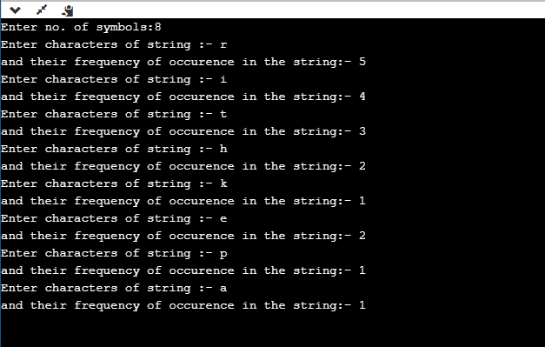
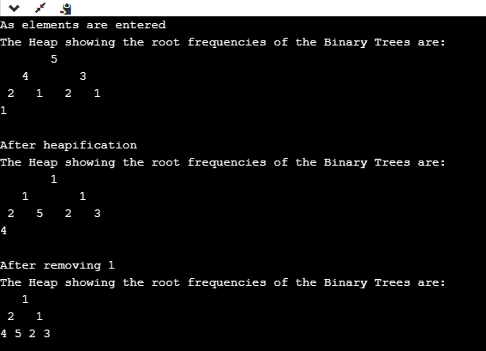
RESULTS
30

Slide 36
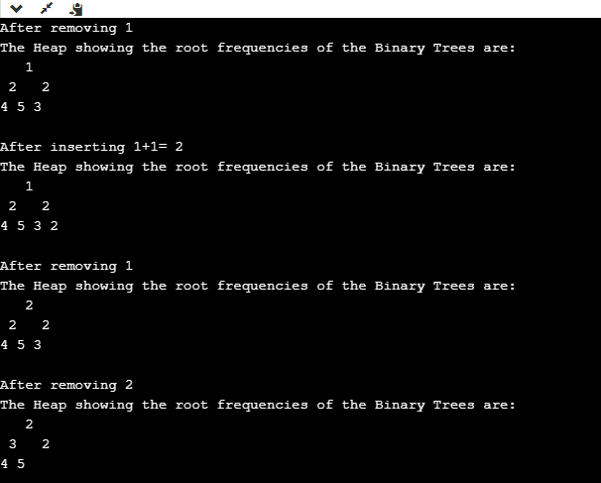
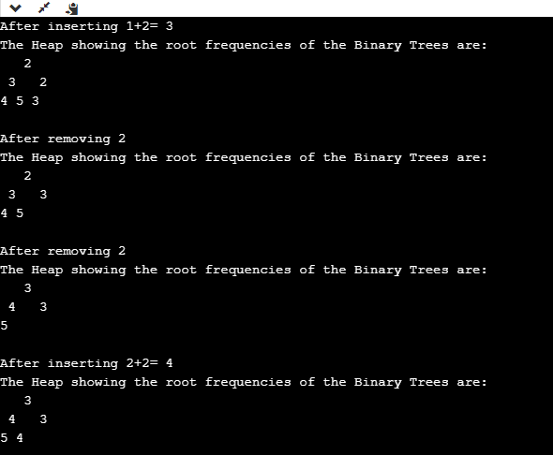
31

Slide 37
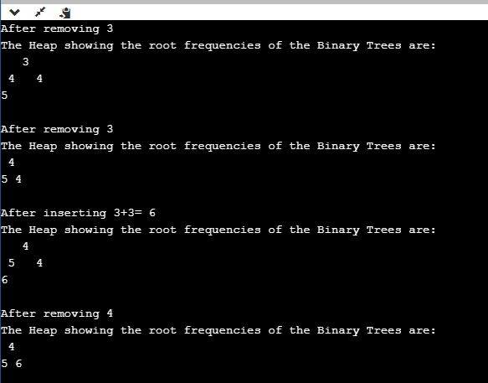
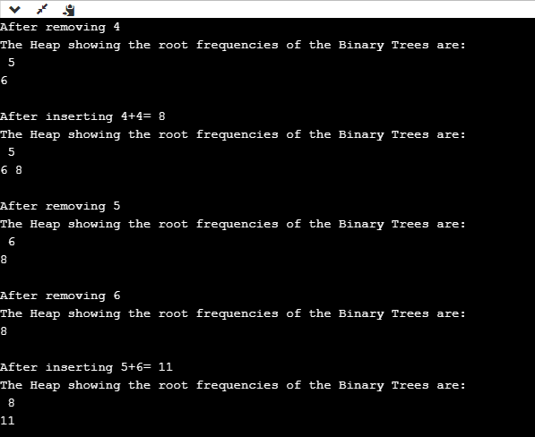
32

Slide 38
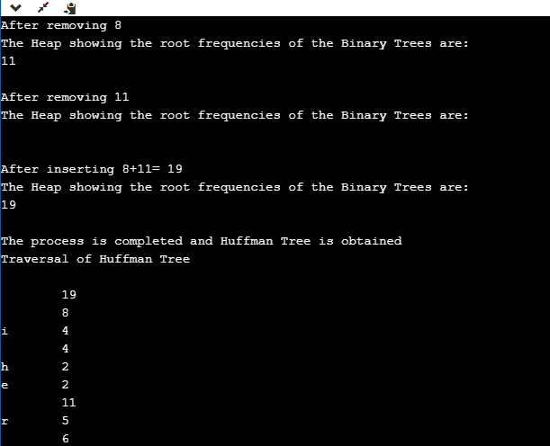
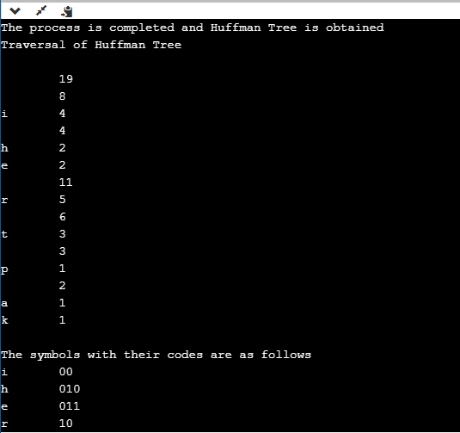
33

Slide 39
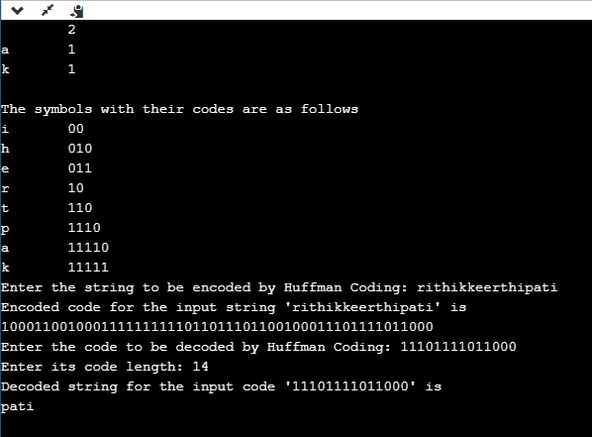
34

Slide 40
ADDITIONAL KNOWLEDGE
We came to know the four variations of Huffman Coding. They are “n-ary Huffman coding” “Adaptive Huffman coding”, “Huffman template algorithm” , “Optimal alphabetic binary trees (Hu-Tucker coding)” and “The canonical Huffman code”.
a. n-ary Huffman Coding
The n-ary Huffman algorithm uses the {0, 1, ... , n − 1} alphabet to encode message and build an n-ary tree.
b. Adaptive Huffman coding
It calculates the probabilities dynamically based on recent actual frequencies in the source string. This is somewhat related to the LZ family of algorithms.
c. Huffman template algorithm
The Huffman template algorithm enables one to use any kind of weights (costs, frequencies, pairs of weights, non-numerical weights) and one of many combining methods (not just addition).
d. Optimal alphabetic binary trees (Hu-Tucker coding)
In the alphabetic version, the alphabetic order of inputs and outputs must be identical. This is also known as the Hu Tucker problem, after the authors of the paper presenting the first linearithmic solution to this optimal binary alphabetic problem, which has some similarities to Huffman algorithm, but is not a variation of this algorithm. These optimal alphabetic binary trees are often used as binary search trees.
e) The canonical Huffman code
If weights corresponding to the alphabetically ordered inputs are in numerical order, the Huffman code has the same lengths as the optimal alphabetic code, which can be found from calculating these lengths, rendering Hu-Tucker coding unnecessary. The code resulting from numerically (re-)ordered input is sometimes called the canonical Huffman code and is often the code used in practice, due to ease of encoding/decoding. The technique for finding this code is sometimes called Huffman-Shannon-Fano coding, since it is optimal like Huffman coding, but alphabetic in weight probability, like Shannon-Fano coding.
35

Slide 41
CONCLUSION AND FUTURE WORK
We would like to conclude that the following features will be learnt and implemented based on today’s applications.
Arithmetic coding can be viewed as a generalization of Huffman coding; indeed, in practice arithmetic coding is often preceded by Huffman coding, as it is easier to find an arithmetic code for a binary input than for a non-binary input. Also, although arithmetic coding offers better compression performance than Huffman coding, Huffman coding is still in wide use because of its simplicity, high speed and lack of encumbrance by patents.
Huffman coding today is often used as a "back-end" to some other compression method. DEFLATE (PKZIP's algorithm) and multimedia codecs such as JPEG and MP3 have a front-end model and quantization followed by Huffman coding.
36

Slide 42
REFERENCES
http://encyclopedia2.thefreedictionary.com/Huffman+tree
http://en.wikipedia.org/wiki/Huffman_coding
http://www.itl.nist.gov/div897/sqg/dads/HTML/codingTree.ht ml
Sartaj Sahani: Data structures, Algorithms and Applications in C++ .
37

